Slide 1
Data Science with Kaggle Decal – Random Forests and AWS
Instructors: Jerry Chen, Joseph Simonian, Phillip Kuznetsov
Website: https://kaggledecal.github.io
Github: https://github.com/kaggledecal/kaggle_fa16
OH: See Piazza
Sign-In: [See board]
Fall ’16

Slide 2
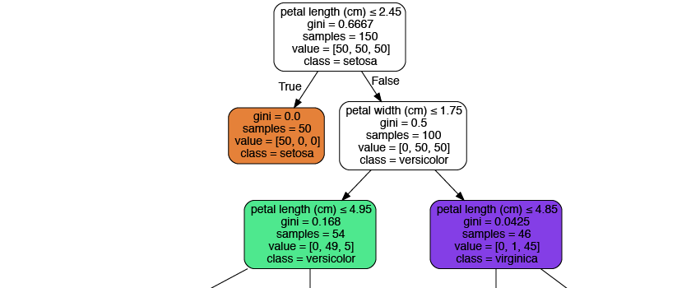
Decision Trees – Iris Data Set
Notice: everything
is a binary split!
Notes:
http://scikit-learn.org/stable/modules/tree.html

Slide 3
Random Forests
It turns out that using a single decision tree to predict is fairly inaccurate.
This is because decision trees fit really well to training data but not necessarily to test data.
A good work around is to make a bunch of decision trees on different subsets of the data, then average the
the predictions from each tree.
This procedure will thus make a forest.
Notes:
https://www.mapr.com/sites/default/files/blogimages/sparkmlrandomforest.png

Slide 4
Random Forests
The random part of RandomForests comes from the fact that we randomly pick which rows and columns of
data to feed into each decision tree.
Consequently, each decision tree we make will be different.
We can then aggregate the predictions from each tree to form
our final prediction.
Notes:
https://www.mapr.com/sites/default/files/blogimages/sparkmlrandomforest.png

Slide 5
Random Forests
The random part of RandomForests comes from the fact that we randomly pick which rows and columns of
data to feed into each decision tree.
Consequently, each decision tree we make will be different.
We can then aggregate the predictions from each tree to form
our final prediction.
Regression
Tree 1: 12.06
Tree 2: 14
Tree 3: 11.59
Tree 4: 10
Tree 5: 12
Final Prediction: 11.93
(Average)
Notes:
https://www.mapr.com/sites/default/files/blogimages/sparkmlrandomforest.png

Slide 6
Random Forests
The random part of RandomForests comes from the fact that we randomly pick which rows and columns of
data to feed into each decision tree.
Consequently, each decision tree we make will be different.
We can then aggregate the predictions from each tree to form
our final prediction.
Regression
Classification
Tree 1: 12.06
Tree 2: 14
Tree 3: 11.59
Tree 4: 10
Tree 5: 12
Final Prediction: 11.93
Tree 1: Freshman
Tree 2: Freshman
Tree 3: Senior
Tree 4: Junior
Tree 5: Freshman
Final Prediction: Freshman
(Average)
(Mode)
Notes:
https://www.mapr.com/sites/default/files/blogimages/sparkmlrandomforest.png

Slide 7
Random Forests - Interpretation
Just as in Linear and Logistic Regression, we can interpret a Random Forest model.

Slide 8
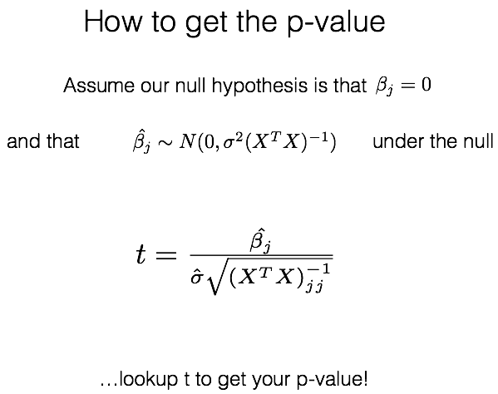
Review – Linear Regression Interpretation
(or use a python package)

Slide 9
Random Forests - Interpretation
Just as in Linear and Logistic Regression, we can interpret a Random Forest model.
Question: How important are my coefficients/variables? Given we have a decision tree, how do we measure this?

Slide 10
Random Forests - Interpretation
Just as in Linear and Logistic Regression, we can interpret a Random Forest model.
Question: How important are my coefficients/variables? Given we have a decision tree, how do we measure this?
Motivation:
What factors influence which company you want to work for?
Which are the most influential?
Notes:
http://i.huffpost.com/gen/1430146/thumbs/o-BEST-COMPANIES-WORK-FOR-570.jpg?1

Slide 11
Random Forests - Interpretation
An intuitive metric to use is the
Gini Index, which measures our error
for multiclass problems, or RSS,
which measures our error for regression
problems.
Specifically, the difference between the
Gini Index before a split and the Gini Index
produced after the split measures how much
the variable captures information (or, removes
noise).
The importance of each variable is obtained
by taking the average of this difference
across all trees.
Notes:
http://scikit-learn.org/stable/modules/tree.html

Slide 12
The Gini Index
2/5 * (1 - 2/5) + 3/5*(1 - 3/5)
1/6 * (1 - 1/6) + 5/6*(1 - 5/6)
Vs.
3/11 * (1 - 3/11) + 8/11*(1 - 8/11)
** So our split helped! ☺

Slide 13
Feature Importance Visual
Notes:
http://imgur.com/Q480Uw4

Slide 14
Feature Importance – Main Disadvantage
Feature importance is very simple to explain and simple to graph.
However, you will find that it does not give you the direction of how a feature impacts your response variable.
Linear and Logistic regression tend to do a better job at answering these kinds of questions.
If my pay increased by $5/hour, how much more likely will I take this job?
If we allocate more funds to Online Ads and decrease funds for TV Ads, will this
increase or decrease our bottom line?
Notes:
http://imgur.com/Q480Uw4

